Slide 1
Impact of Short Term Electricity Procurement of an Open Access Consumer on Indian Grid
Abstract
Introduction
UI Mechanism
Problem Description and Formulation
Case Study and Results
Conclusion

Slide 2
Abstract
UI mechanism → powerful tool for maintaining grid discipline, penalizing the market players who cause deviations in the system
Buyer pays UI penalty for over-withdrawal of power based on the grid condition in real time
Objective
Planning model for a large OA consumer in India, purchasing from bilateral contracts and multiple Day Ahead Markets (DAMs) shifting consumer's expected demand by accounting the UI deviations to minimize procurement cost
Overall problem of cost and risk minimization is handled by mean variance approach
Consumer can plan demand scheduling for the planning period and thus help in improving grid frequency at the real time
Considerations
Small self generation unit
RPO
Price uncertainty of both markets

Slide 3
Introduction
Power sector reforms to improve functional, financial and technical performance
Policy makers brought in regulatory changes → Electricity Act 2003
OA to have non-discriminatory access to the transmission and distribution lines to support power trading for fair and competitive power market
Liberalized the power sector with the flexible entry of multiple market participants developing competitive power markets for consumer benefit by better economic performance through short term trading
PXs based short term transactions bring in transparency and competition in power markets
Short term bilateral contracts are mostly the inter-state or inter-regional contracts approved by CERC
PXs are the trading platforms for spot trading, various type of products like TAM and DAM, traded by continuous bidding or auctions
2 PXs in India → Indian Energy Exchange (IEX) and Power Exchange of India (PXIL)
UI mechanism penalizes generators or consumers for deviating from scheduled injections or withdrawals respectively and supports real time grid frequency balancing
Share of short term trading in annual electricity procurement is 9% in 2014-15

Slide 4
Market participants trade electricity at market deciding price and can achieve proficiency through selection of favorable options
Benefit from the transparency in the price of electricity and meet their demand fluctuations in real time
OA consumers in India can be private industries, government-owned companies, etc. with access to the grid
Over withdrawal at real time can worsen grid frequency increasing penalty for consumer
Under withdrawing when grid frequency is falling below 50 Hz will balance grid frequency
Large consumers are capable of scheduling their consumption with flexibility in response to price fluctuations and penalties in UI mechanism thus helping in grid frequency balancing
Procurement strategy for OA consumer in short term trading market with consumption scheduling to address the real time grid frequency imbalances
Optimal electricity procurement problem for large OA consumers under the UI penalty mechanism
Uncertainty of day ahead spot markets, and RPO are considered
Cost and risk minimizing problem analyzes the real time contributions of the planning model on the system frequency

Slide 5
UI Mechanism
UI Mechanism → introduced in 2002 as part of Availability Based Tariff (ABT)
ABT → a rational tariff structure designed for generating stations
Sellers and buyers of electricity have to pay penalty for causing deviations (under injection and over withdrawal respectively) at the real time for unhealthy grid frequency
Objective of maintaining grid frequency in the narrow band of 49.90 Hz to 50.05 Hz as per IEGC
Deviations are determined through special metering in 15-minute time block
Scheduling of injection and withdrawal is done by Load Dispatch Centers (LDC)
SLDCs manage the transmission system in their respective grids
RLDCs manage and operate regional grids, prepare the dispatch and withdrawal schedule for the suppliers and consumers considering availability, network constraints, and securities

Slide 6
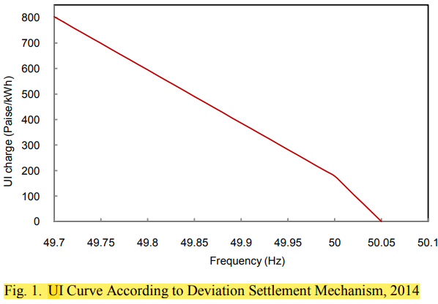
CERC specifies the penalty rates according to grid frequency
According to DSM Regulations 2014, additional UI charges are levied for a consumer who withdraws over 12 % of its scheduled demand or 150 MW
UI charges for under withdrawal over 12 % or 150 MW are zero to discourage consumers for manipulating the trade to earn benefits
Consumer is over withdrawing within the permissible deviation ie less than the minimum of 12% of scheduled interchange or 150 MW for frequency band 49.7 Hz to 50.05 Hz.

Slide 7
Problem Description and Formulation
OA large consumer or Distribution Company (discom) participate in the short term power market and are obligated to fulfill RPO
Participating in DAM through both the power exchanges and are large enough to impact the grid frequency
Flexibility in its base demand to address the projected variations
Self generation and bilateral contracts are also available options
Planning consumption schedule in order to get minimum cost considering uncertainty of prices of both DAMs
Uncertainty of both the market prices modeled through variance
Overall problem for the large consumer is of cost minimization while managing the risk of multiple DAM prices
UI rate calculated using the grid frequency condition
Policy change issues are neglected.

Slide 8
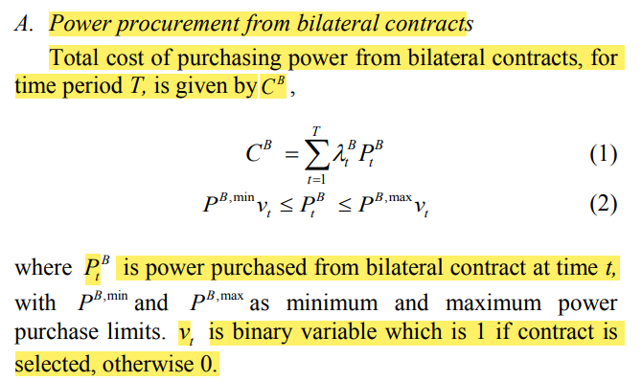
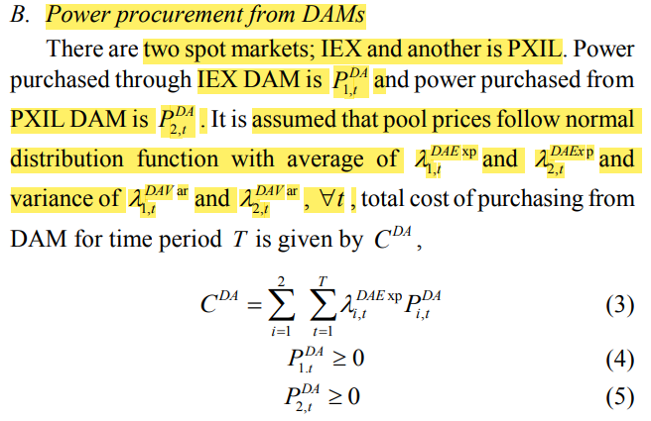

Slide 9
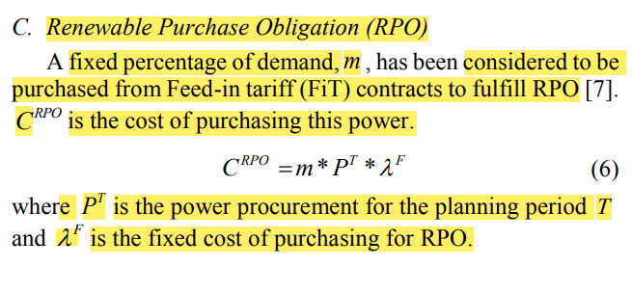
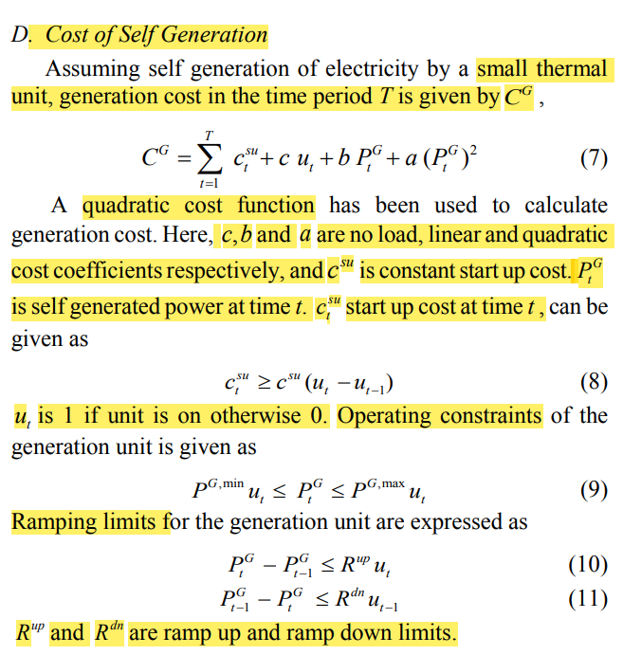

Slide 10
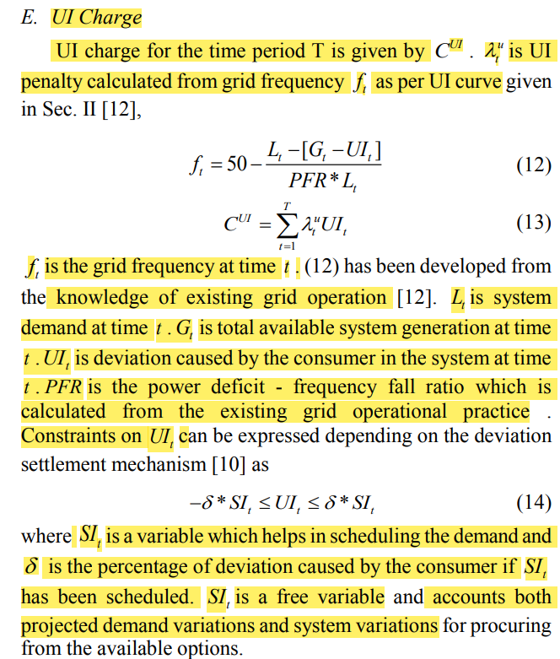

Slide 11
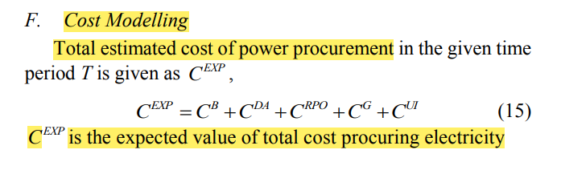
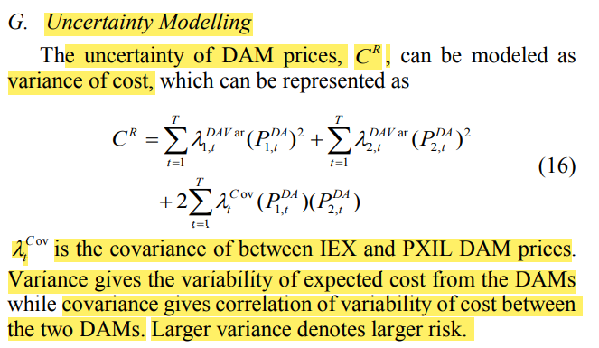

Slide 12
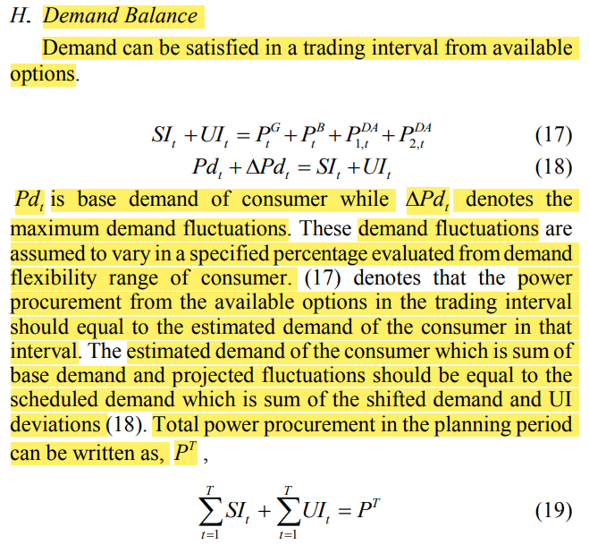

Slide 13
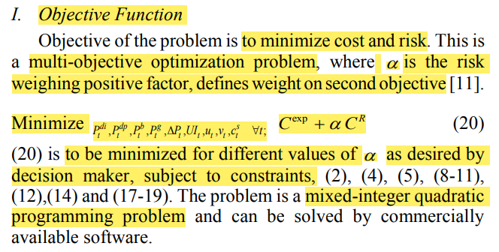

Slide 14
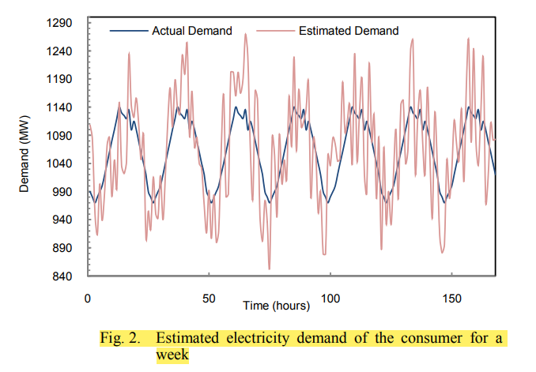
Case Study and Results
OA large consumer in western regional grid planning its weekly electricity procurement from two DAMs and one bilateral contract
Small self generation facility
Each hour is a trading interval, total trading intervals are 168 hours
Estimated electricity demand varies between 970 MW and 1140 MW
Demand flexibility offered by the consumer is 12 % of the base demand
Consumer can make one bilateral contract and its price is Rs.3000/MWh with minimum and maximum trading limit as 30 MWh and 800 MWh respectively

Slide 15
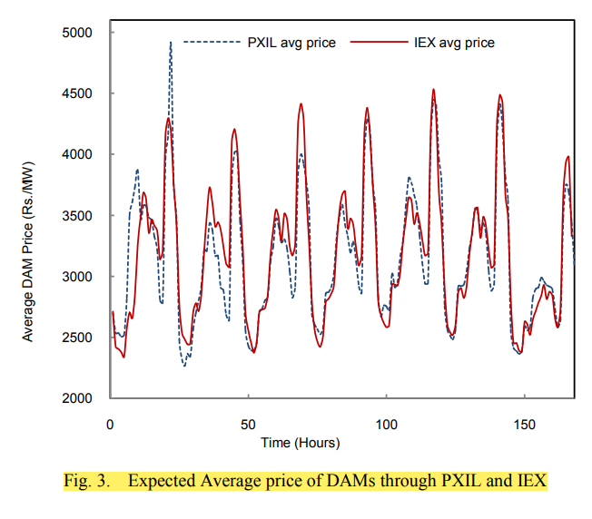
Expected DAM prices for IEX and PXIL are calculated from the average of 10 consecutive weeks in the year 2011.
Average price for IEX and PXIL spot market are Rs.3154.307/MWh and Rs.3182.883/MWh respectively
Consumer is mandated to 10 % RPO
Cost of purchasing for the RPO is Rs.5000/MWh
Data for self generation unit
Capacity | 120 MW
Minimum Power output | 20 MW
Ramping Limit (up/down) | 80 MW
Quadratic cost | Rs. 0.6/(MW)²h
Linear cost | Rs. 2700/MWh
No-load cost | Rs. 2000
Startup cost | Rs. 1000

Slide 16
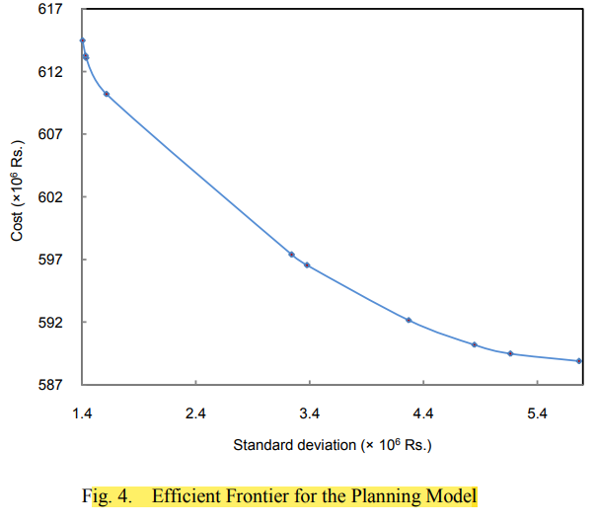
Total system demand as Indian grid system is considered as 100GW
Total generation for nominal grid frequency is taken as 100 GW
Pre-existing deviations are considered in the system
To find the optimum decision, objective is to be minimized with the constraints taken under consideration
The cost of purchasing from given options decreases with the increase of standard deviation i.e. risk
A risk taking consumer can purchase electricity at relatively less cost as compared to the risk-averse consumer
Standard deviation of net cost is the square root of cost variance

Slide 17
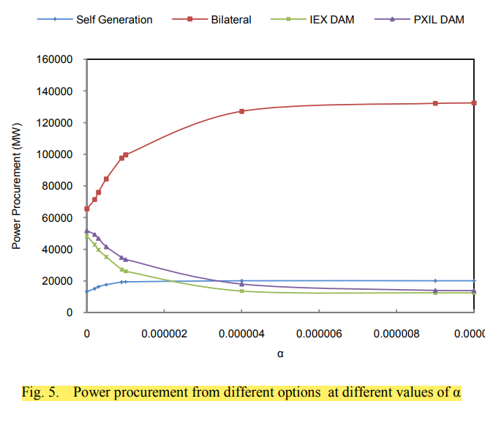
Power allocation for the risky assets like IEX market and PXIL market both start decreasing as the value of α starts increasing i.e. risk starts decreasing
Purchase from these markets is maximum at α = 0
Purchase from other options like bilateral contract and self generation starts increasing as the value of α starts increasing
They become constant at the higher values of α
UI allocation and scheduled demand are unaffected from the values of risk

Slide 18
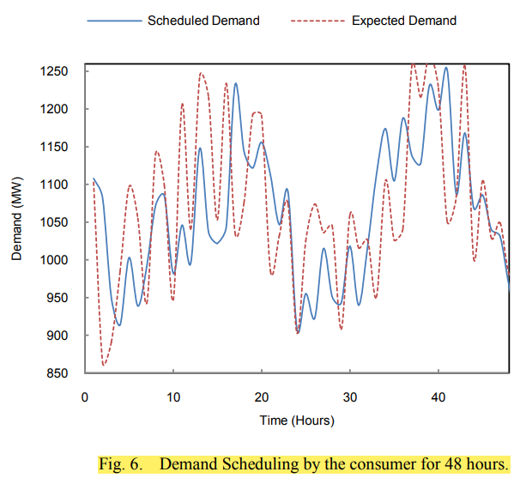
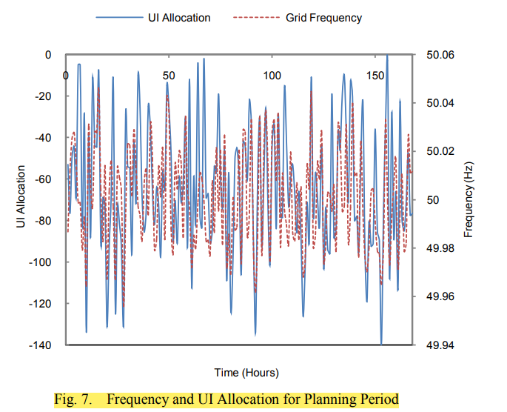
Scheduled demand has been shifted as compared to the expected demand to account the UI deviations
Linear relation between frequency and UI penalty is considered instead of piecewise UI curve
Linearity of frequency is evident on the UI allocation
UI allocation is always negative to improve the grid frequency

Slide 19
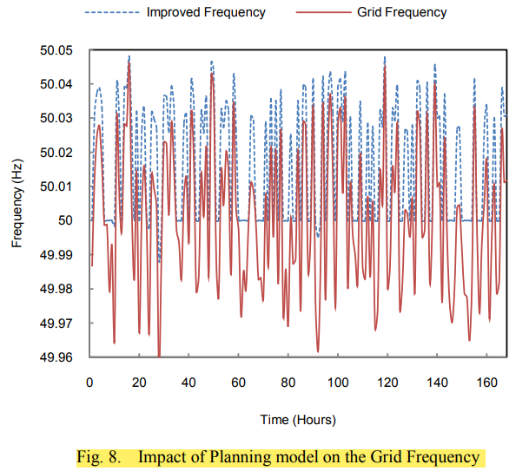
When grid frequency is below 50 Hz, UI allocation is more negative and when grid frequency is above 50 Hz, UI allocation is less negative
When grid frequency is falling at a dangerous low level, then consumer can under withdraw resulting in improved frequency at real time
Consumer has shifted demand into other hours in the considered period which can be decreased at the real time
Consumer decides minimum cost electricity procurement for a week
For the state DISCOMS the model is useful for better planning of electricity procurement avoiding load shedding as a real time balancing mechanism and implementing demand response programs
Demand scheduling is done such that expected variations in base demand as well as UI deviations are accounted
If implemented for a retailer this model can help in better management of its resources while participating in demand response

Slide 20
Conclusion
Planning model for an OA large consumer among trading options like bilateral contract, self generation and multiple DAMs
Considerations
Demand flexibility at the real time accounts for UI mechanism
Estimated variations in the base demand are considered while scheduling the demand
Risk arising due to the uncertain DAM price modeled by mean variance approach
The consumer can schedule its withdrawal before a week for optimal power purchase
Results
Procurement from DAMs are higher at higher risk values which decreases with decreasing risk
Procurement from bilateral contracts and self generation increases with the increasing risk values
Flexibility in demand due to demand fluctuations helps in improving grid frequency
UI is a part of planning to show the impact of consumer demand response on grid frequency
Implementation of this problem is to be done in two separate sections viz planning and real time operation highlighting the impact of UI

